Slide 1
NBA Positions End to End ML
Can you predict positions with just box score data?
Sam Kenney

Slide 2
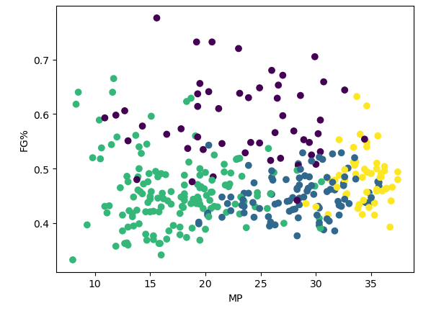
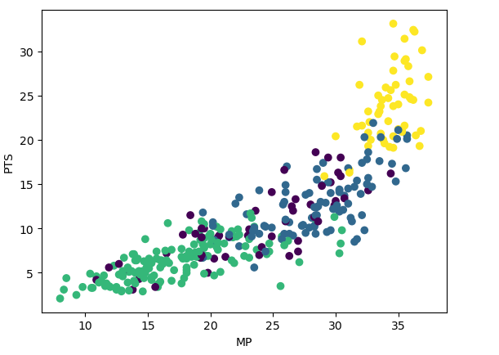
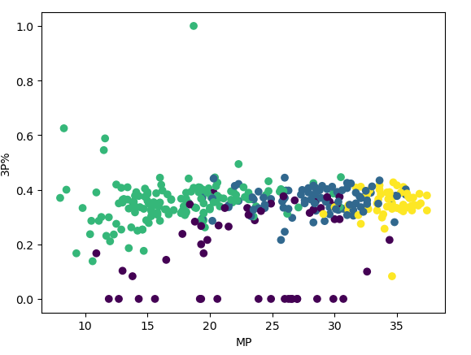
Past Project
Notes:
KMeans clustering of 2022-23 NBA players
Set out to find whether positionless basketball could be redefined into new positions
Good at predicting centers for position, not very much else
Came up with this- yellow = stars, purple = centers, green = bad players, blue = role players
Decided to update this with new data for 2023-24 NBA season
Also try different models and try to successfully predict positions

Slide 3
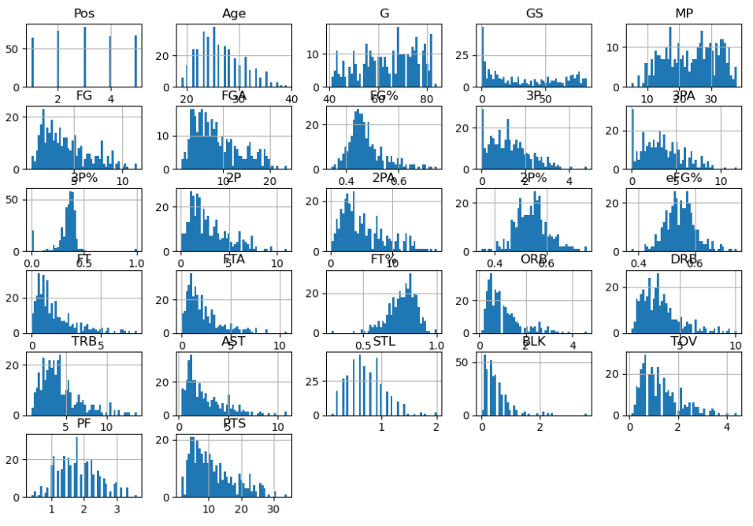
Data Visualization
Notes:
Sorry it overlaps somewhat
Wanted to see what data was useful- obvious could rule out age, games started
Somewhat normally distributed or skewed
Large amount of data, very difficult to correct for all categories skewed
Used min-max scaling because of differences in data

Slide 4
Challenges
How many models to build + which?
Ensuring correct scaling
Array shapes for neural network
Hyperparameter tuning
Notes:
Did not know which models to use at first, ended up going with those we learned in homework 4,
(ada boost, decision tree, random forest, neural network)
Stratification- went with by minutes bcuz didn’t want to overweight for star players who tend to take on more roles
Because so many features and many not normally distributed, data pipeline seemed too difficult
Forgot to reshape an array for neural network, caused a bug that took way too long to figure out
altered the neural network to become softmax output rather than sigmoid (output multiple classes)
Had to change label to become 0-4 instead of 1-5 for softmax output, confusing at first
gridsearchCV takes a while and also not sure which parameters to use, opted instead for randomizedSearchCV
did not work well for adaBoost

Slide 5
Results (accuracy)
AdaBoost: 44% train, 41% test
Random Forest: 63% train, 52% test
Decision Tree: 57% train, 50% test
Neural Network: 52% train, 51% test
Notes:
Overall random forest seemed to be the best according to accuracy metric
AdaBoost likely had bad hyperparameters - underfit to data
Otherwise fairly decent results, not too too much overfitting

Slide 6
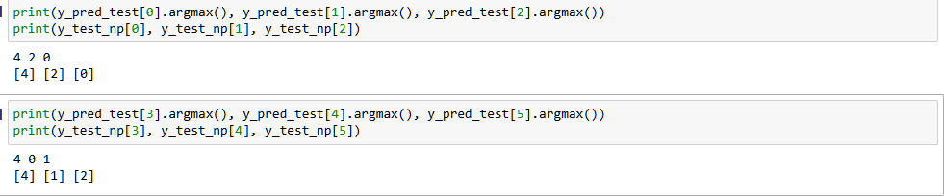
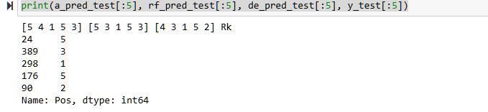
Results (predictions)
Neural network predictions
Tree classifier predictions
Notes:
Predictions make accuracy look slightly better-
Positions are actually very close to actual
Ex: 4 and 5 both rebound + shoot high percentages, 1+2 both get assists and shoot many threes
Would’ve changed method of accuracy measure/use float for predictions if done again to see how close to actual predictions

Slide 7
Verdict:
Can you predict positions with just box score data?
Yes!
Notes:
Overall, indicates NBA is not as positionless as coaches and media would have you believe, even fairly simple machine learning algorithms can predict positions based on the basic box score statistics.

